Slide 1
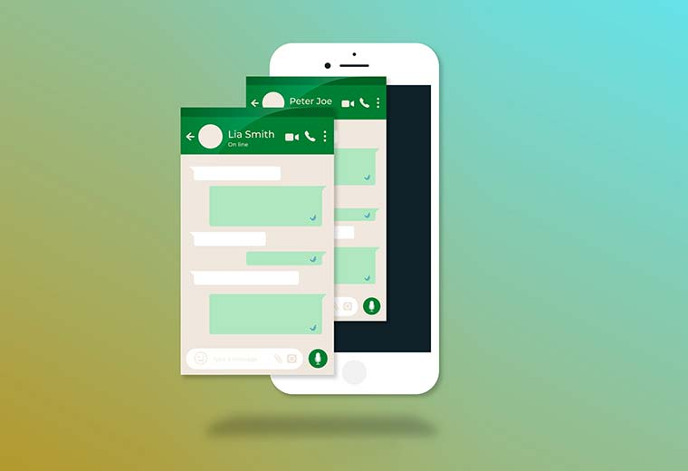

Slide 2

CHAT APPLICATION
Batch – 87
Team Members:
Ganya H T
Shashanka H
Rahul G N

Slide 3
Contents
Introduction
Problem Statement
Proposed Solution
Technologies
Screenshots

Slide 4
INTRODUCTION
A chat application provides the instant communication functionality between users.
The users have the capability to do the one to one communications.
The chat application makes it easy to communicate with people anywhere in the world by sending and receiving messages in real time.
Our project provides the simple and easy GUI for the users.

Slide 5
PROBLEM STATEMENT
This project aims to develop a chat application with server and users to enable the users to chat with each others.
The project should provides an instant messaging solution to enable users to seamlessly communicate with each other.
The project should be very easy to use enabling even a novice person to use it.

Slide 6
PROPOSED SOLUTION
The proposed system would be able to do the following on
each individual user’s terminal:
User Authentication/Registration.
User Login.
Add user: This option would be used to add a new
user to the contact list.
Group chat and Private Chat.
Logout.

Slide 7
REQUIREMENTS
Front end : React js
Back end : java spring boot,Mongodb
Platform Technologies : vscode , Mongodb atlas
FrameWork : Java Spring Boot

Slide 8
SCREENSHOTS
HOME PAGE

Slide 9
REGISTER PAGE

Slide 10
LOGIN PAGE

Slide 11
PRODUCT LIST

Slide 12
CART PAGE

Slide 13
ORDER CONFIRMATION PAGE

Slide 14


